Slide 1
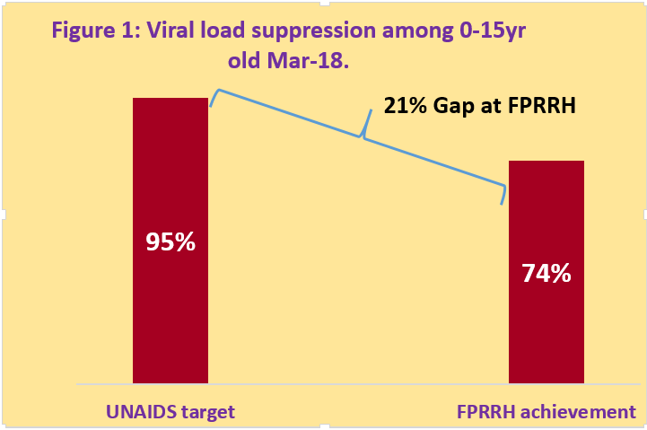
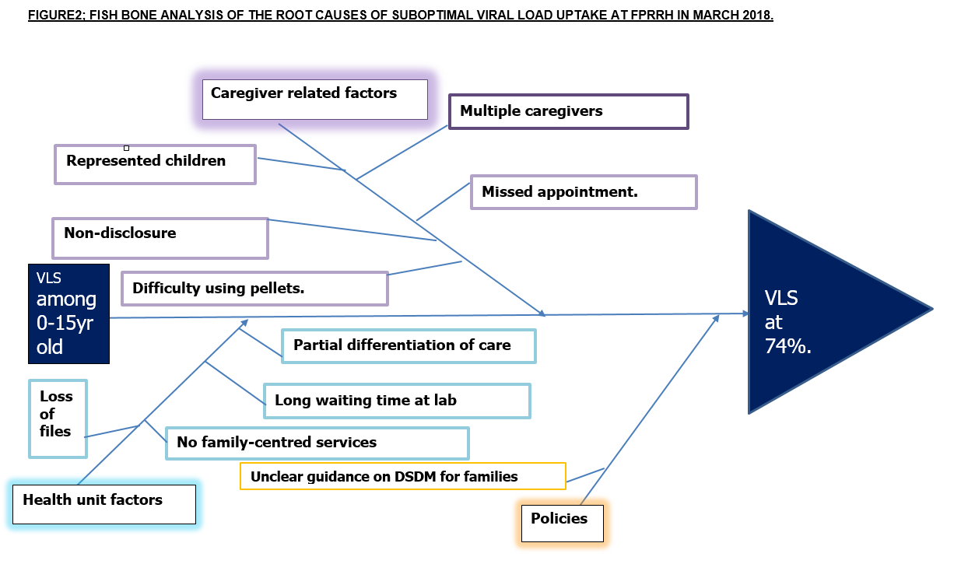
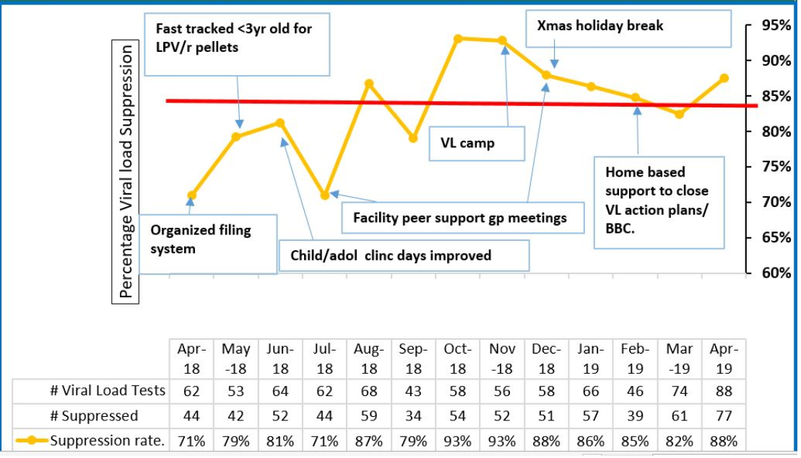
Improving viral load suppression rates among HIV positive children on ART in a large volume HIV clinic in Western Uganda
Akobye¹, P. Nahirya Ntege², A. Bigirwa¹, R. Ahurra³, J. Musinguzi⁴, P. Nyakaana⁵, G. Matsiko⁶, G. Ategeka⁷, F. Tugumisirize⁸, P. Elyanu²
¹Baylor College of Medicine Children's foundation-Uganda., Medical, Fort Portal, Uganda, ²Baylor College of Medicine Children's Foundation -Uganda, Research, Kampala, Uganda, ³Fort Portal Regional Referral Hospital, Psychosocial, Fort Portal, Uganda, ⁴Fort Portal Regional Referral Hospital, Records, Fort Portal, Uganda, ⁵Kabarole People Living with HIV Forum, Community, Fort Portal, Uganda, ⁶Hakibaale Kwemanyira Community Based Organization, C0mmunity, Fort Portal, Uganda, ⁷Fort Portal Regional Referral Hospital, Medical, Fort Portal, Uganda, ⁸Fort Portal Regional Referral Hospital, Administration, Fort Portal, Uganda
Background:
95% viral suppression among HIV clients on ART is critical to ending HIV/AIDS by 2030. The gap for FPRRH is shown in figure 1.
Unsuppressed viral load delays growth and development, increases the risk of opportunistic infections and death.
AIM; To increase VLS among CLHIV (0-15 years) from 74% in March-2018 to 85% in April-2019 .
Description:
A quality improvement project was conducted
Team composition.
Health workers,
Adolescents
PLHIV representatives
We used;
Brainstorming to identify root causes (Figure2)
Driver diagrams to identify the likely interventions
Focusing matrix to prioritize the interventions.
Plan-Do-Study-Act cycle to monitor the project.
Data was extracted from the national VL dashboard, analysed for proportion of children with suppressed VL between Apr-18 and Apr-19.
Lessons:
Reasons for low VLS in Figure 2.
VLS increased from 74% in March-2018 to 85% in April-2019. (Figure 3)
Conclusions:
Stakeholder involvement and provision of patient-centered interventions can bridge the gap in viral load suppression among CHLIV to reach UNAIDS targets.
Low availability and difficulty administering lopinavir/ritonavir require innovative solutions.
Acknowledgement.
Figure 3: Interventions to improve viral load suppression among 0-15yr olds at FPRRH Apr 2018-Apr 2019.
PRESENTED AT THE 23RD INTERNATIONAL AIDS CONFERENCE (AIDS 2020) | 6-10 JULY 2020

